Slide 1
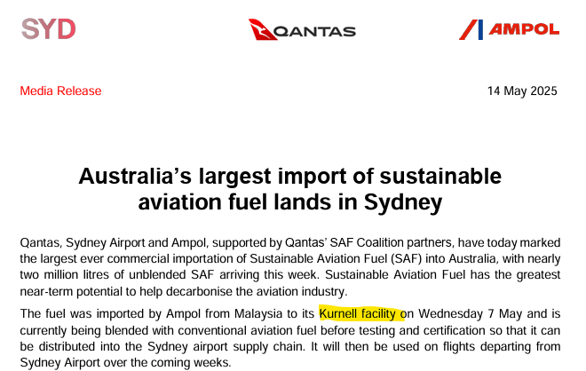
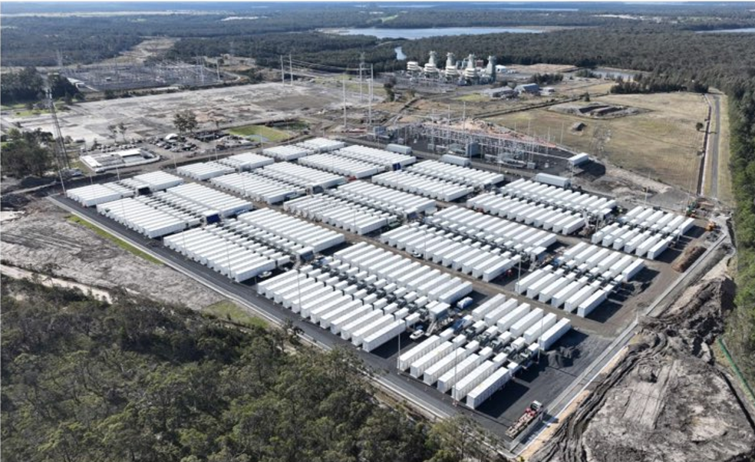
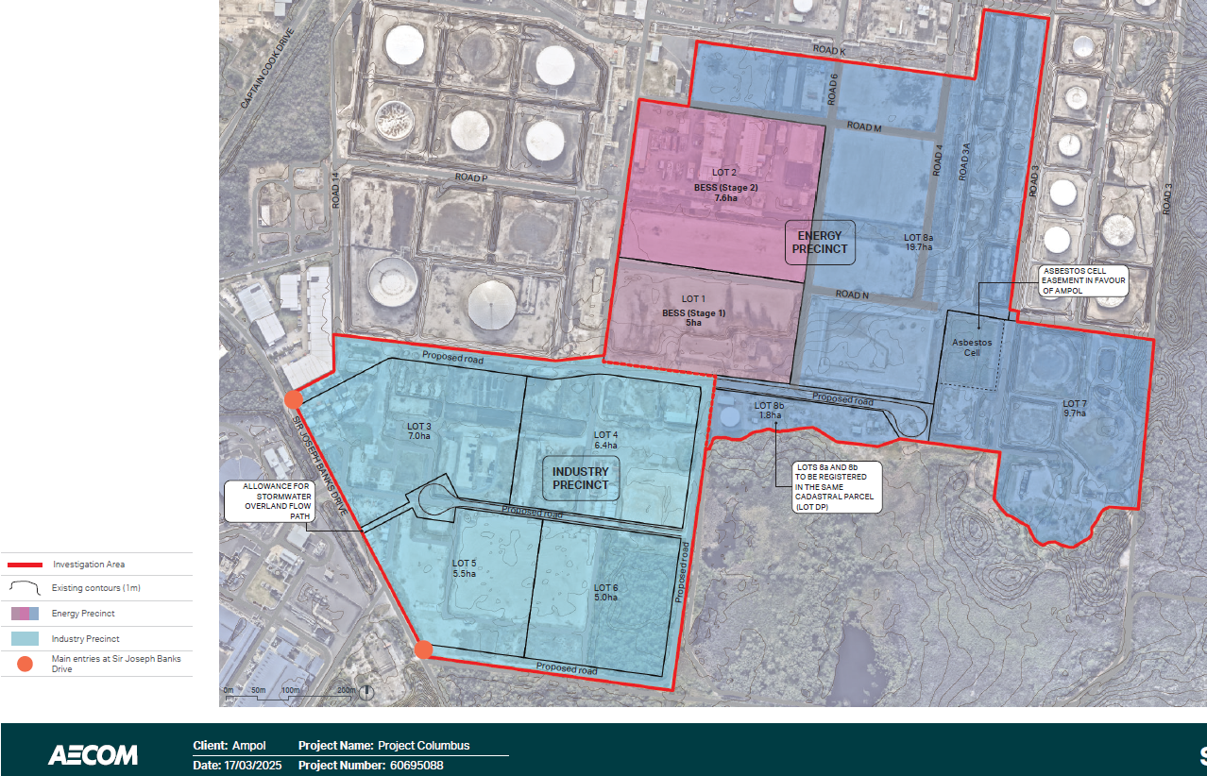
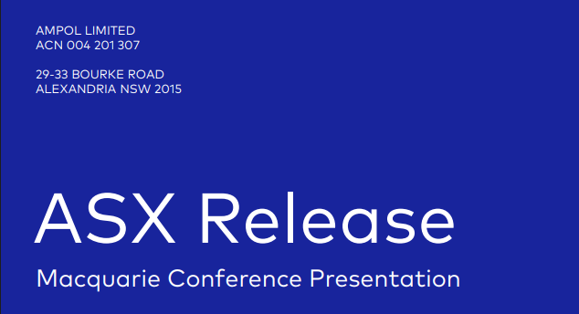

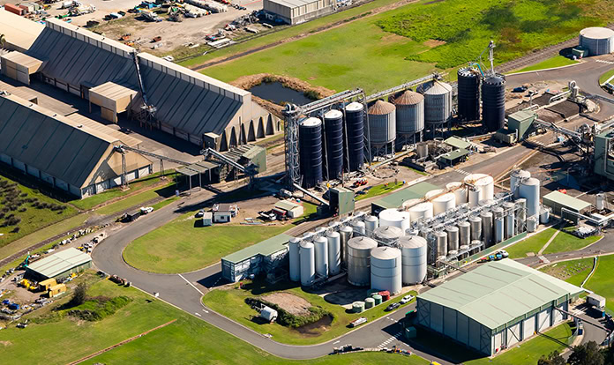
Its 2027, Ampol’s Kurnell Industry & Energy site is humming…
AMPOL reduces costs
Uplifts revenue
Reduces accountability
Shareholders happy
To be announced soon
Disclaimer: this presentation explores a hypothetical situation and is not intended to represent a prediction of future events
Cargill Newcastle

Slide 2
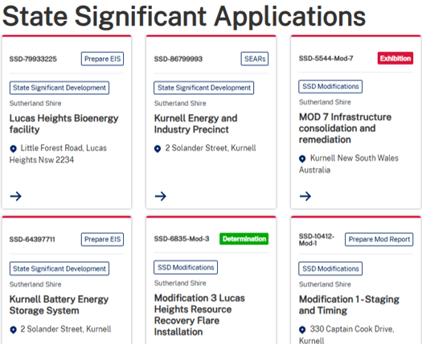
Ampol's Kurnell Shift: From Full Cleanup to Permanent Containment & Energy Hub – community risks ahead
Mod 7 Changes | Before Mod 7 (what was approved) | After Mod 7 (If Approved) | What This Means (Future Land Use – Community View)
Remediation of Contaminated Soil/Groundwater (e.g. hydrocarbons, PFAS) | All contaminated materials must be transported off-site | Contamination contained and capped on-site permanently | Ampol keeps toxins on site, saves costs. Community loses full cleanup rights
Waste Management and Containment (e.g. asbestos) | Excavation and off-site transport; no permanent on-site approval | Waste is consolidated on-site with capping layers | Ampol keeps waste on-site, saves cost. Community loses off-site disposal, facing ongoing pollution risks without relocation.
Environmental Audits and Monitoring | Audits required during works, submitted to authorities. | Monitoring via reports, no new independent audits for capped areas. | Ampol self-monitors post-capping. Community loses independent checks
Future Land Use and Zoning | Remediation allows potential non-hazardous rezoning post-cleanup | Capping reinforces industrial zoning, Land will ALWAYS be heavy industrial, cannot change | Ampol locks in industrial use. Community loses rezoning for parks, enables BESS & SAF blending
Flooding and Leak Risks to Wetlands/Bay | Leaks prevented through removal | Flood risks, capping uses redirections | Ampol operates with flood barriers. Community loses full protections, facing bay contamination
Timeline for Remediation Works | Deadlines for waste management extended to March 2020 | Works extended, with capping allowing indefinite monitoring post-installation. | Ampol extends control without end dates. Community loses timelines, facing endless uncertainty for site safety.
2
AMPOL has Multiple
1
2
3
Disclaimer - Community perspective based on public docs
https://www.planningportal.nsw.gov.au/major-projects/projects/mod-7-infrastructure-consolidation-and-remediation
Subdivision
Ampol Strategy
Monetise Kurnell site
Reduce costs
Minimise accountability
Subdivide Land
1. Energy Precinct
2. Industry Precinct
=
- BESS
- Enables future industrial uses e.g. SAF Blending, other
- Multiple Stakeholders & ongoing uncertainty
Mod 7 Approval
No remediation
No Zoning change

Slide 3
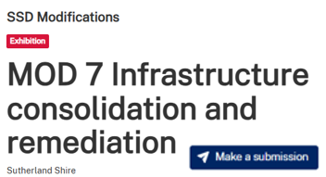

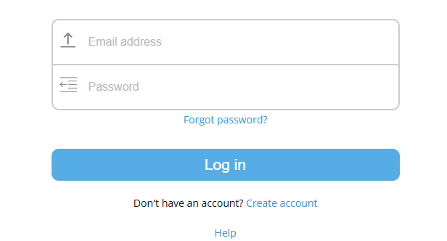
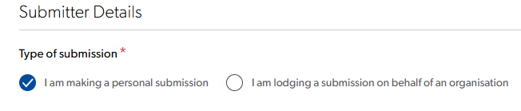
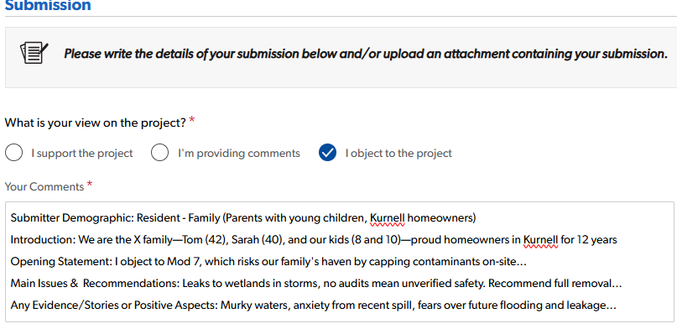
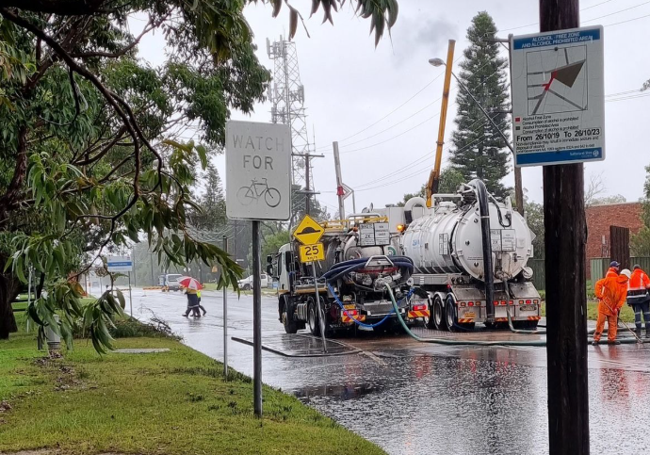

CALL TO ACTION
Object Now!!
Only opportunity to have your say. No plan B
Mod 7 closes 25th July 2025
We need ~80 unique submissions to trigger Independent Planning Commission (IPC) for determination!
Can be from same household. Similar/same submissions are counted as one.
Anyone outside Kurnell can object, however only those within a close proximity will be included.
IPC, not part of Dept Planning, Housing,& Infra - makes final decision
Steps
NSW Gov Planning Portal
1
or
https://www.planningportal.nsw.gov.au/major-projects/projects/mod-7-infrastructure-consolidation-and-remediation
Create Account or Login
2
Recommend one account per person
3
Select submission Type
Write & upload submission
Very important to follow structure – see example
Some examples of objection reasons…
Contamination, toxins, capping, health,
Subdivision, land use, multiple stakeholders
Ongoing disasters, flooding, who is accountable
Pollution Types: Air, Water, Odor, Noise, Waste
Safety, transport, roads, lack of audits
Environmental, biodiversity, tourism, businesses
4
Disclaimer - Community perspective based on public docs

Slide 4
Submitter Characteristics (not needed for submission) | Introduction (Introduce yourself/group, acknowledge opportunity, note relevant work) | Strong Opening Statement (Focus on key issues relevant to you) | Recommendations (Strong clear statements, e.g., 'the proposal should be rejected because...') | Evidence/Arguments (Use facts from documents, case studies, local knowledge; include examples from Ampol's Scoping Report, Mod7 Report) | Positive Aspects (If any, or why none outweigh negatives) | Closing (Contact details, request reply/meeting, date)
Young family with children | I'm a Kurnell parent with two young kids under 5. We've lived here for 5 years for the natural environment. Thanks for the submission chance; I’ve also tracked local pollution issues. | Mod 7 favors Ampol's costs over kids' safety by capping toxins on-site, risking leaks/floods. | Reject Mod 7. Stick to off-site removal, add audits/timelines for cleanup/rezoning to parks. | Keeps PFAS/toxins on-site forever, saving costs but risking bay leaks (Mod7 Report (Sec 4, Pg 60) Refinery history caused contamination (Scoping Report (Pg 27) Community loses cleanup rights, faces uncertainty (PPTX: Sec 3, Pg 53 no end) As parents, kids play near bay; PFAS studies show health risks like in polluted sites. | Energy ideas lock industry (E5 zoning, Fig B-2 Pg 240); no positives for family safety. | [Name], [Address], [Email], [Phone]. Reply/meet on family concerns. July 16, 2025.
Elderly couple | We're retirees in Kurnell 40+ years, seen refinery changes. Appreciate the chance to submit; we've joined past environmental talks. | Mod 7 breaks trust with on-site waste capping, leaving pollution legacy. | Deny Mod 7. Require off-site disposal, audits/deadlines for rezoning preservation. | Consolidates asbestos/toxins locally, perpetual risks (Mod7 Report Fig 4-3 Pg 58): Sec 4 Pg 60) Flood threats to bay (Mod7 Report Fig 7-5 Pg 111) Industrial lock-in (Scoping Report (Pg 215): E5 zoning Fig B-2 Pg 240) Past leaks affected us; self-monitoring & no ends unreliable, like historical spills harming ecology (App G Pg 8 & Sec 3 Pg 53) | Subdivision reduces accountability; jobs don't outweigh risks. | [Names], [Address], [Email], [Phone]. Response/meeting on long-term effects. July 16, 2025.
Local business owner | I run Kurnell eco-tours 15 years. This submission is vital as Mod 7 directly threatens our local economy. I've worked with green groups on site concerns. | Mod 7's capping risks contamination, deterring tourists/hurting businesses. | Block Mod 7. Mandate off-site removal, audits/rezoning for tourism over industry. | Containment exposes bay to floods (Mod7 Report Sec 4 Pg 60): Fig 7-5 Pg 111) Contamination history; capping enables BESS/SAF but locks zoning (Scoping Report (Pg 27 Fig B-2 Pg 240) Tours hit by pollution stigma; indefinite works uncertain, like sites with tourism drops (Sec 3 Pg 53) | SAF jobs with uncertainty; not worth tourism hit. | [Name/Business], [Address], [Email], [Phone]. Reply/business meeting. July 16, 2025.
Passionate environmentalist | I'm a Kurnell resident active in environmental groups for 10 years, monitoring refinery impacts. Thanks for submission opportunity | Mod 7 sacrifices ecology with toxin capping, threatening bay biodiversity. | Reject Mod 7. Demand off-site remediation, offsets/rezoning for restoration. | PFAS containment; floods risk wetlands (Mod7 Report (Sec 4 Pg 60 Fig 7-5 Pg 111) Threatened species; capping endangers runoff (Scoping Report Pg 51: Fig 4-3 Pg 58) No audits & indefinite evade responsibility; PFAS cases harm ecosystems. Zoning blocks green spaces (App G Pg 8, Sec 3 Pg 53, Fig B-2 Pg 240) | "Sustainability" (App G) hollow; no benefits for wetlands. | [Name], [Address], [Email], [Phone]. Reply/eco-meeting. July 16, 2025.
Disclaimer: Submission examples only

Slide 5
CALL TO ACTION
Object Now
Only opportunity to have your say. No plan B
Mod 7 closes 25th July 2025
Ampol's Kurnell Shift: From Full Cleanup to Permanent Containment & Energy Hub
Mod 7 Changes | Before Mod 7 (what was approved) | After Mod 7 (If Approved) | What This Means (Future Land Use – Community View) | Reference (Mod 7 – link below)
Remediation Method for Contaminated Soil/Groundwater | Contaminated materials (e.g., hydrocarbons, PFAS, asbestos) must be excavated, handled, managed, and transported off-site. | Contaminated materials are excavated but contained and capped on-site permanently. | Ampol keeps toxins on-site forever, saving costs. Community loses full cleanup rights, risking ongoing leaks and limited land reuse. | Section 4, PAGE60 (on-site containment details).
Waste Management and Containment | Waste management requires excavation and off-site transport; no permanent on-site approval. | Waste is consolidated on-site in cells with capping layers. | Ampol retains waste locally, reducing transport needs. Community loses off-site disposal, facing perpetual pollution risks without relocation. | Figure 4-3, PAGE58 (capping areas for consolidation).
Environmental Audits and Monitoring | Audits required during works, including dilapidation reports submitted to authorities. | Monitoring via reports, but no new independent audits for capped areas. | Ampol self-monitors post-capping. Community loses independent checks, risking undetected issues without enforcement. | Appendix G, PAGE8 (ongoing monitoring with sustainability reports).
Future Land Use and Zoning | Zoning IN1, but remediation allows potential non-hazardous rezoning post-cleanup. | Capping reinforces industrial zoning, restricting changes due to hazards. Land will ALWAYS be heavy industrial, cannot change | Ampol locks in industrial use. Community loses rezoning for parks, enables BESS & SAF blending | Section 8.1 PAGE215 (E5 Heavy Industrial). Figure B-2 Land Zoning Map PAGE240 PAGE27 Scoping Report – Kurnell Energy & Industry Precinct
Flooding and Leak Risks to Wetlands/Bay | Management prevents leaks through removal; stormwater handled to avoid residuals. | Flood models show risks, with capping using levees; possible leaching to bay. | Ampol operates with flood barriers. Community loses full protections, facing bay contamination threats in storms. | Figure 7-5 PAGE111 (flood depth and tide event risks).
Timeline for Remediation Works | Deadlines for waste management extended to March 2020, focusing on phased completion. | Works extended, with capping allowing indefinite monitoring post-installation. | Ampol extends control without end dates. Community loses timelines, facing endless uncertainty for site safety. | Section 3, PAGE53 (ongoing remediation expected indefinitely).
Subdivision
https://www.planningportal.nsw.gov.au/major-projects/projects/mod-7-infrastructure-consolidation-and-remediation
Disclaimer - Community perspective based on public docs
- BESS
- Enables future industrial uses e.g. SAF Blending, other
- Multiple Stakeholders & ongoing uncertainty
Ampol Strategy
Monetise Kurnell site
Reduce costs
Minimise accountability
=
Mod 7 Approval
No remediation
No Zoning change
Subdivide Land
1. Energy Precinct
2. Industry Precinct

